Slide 1
Monthly Meeting
March 13th, 2024

Slide 2
Introductions
Any attendees here for the first time are welcome to briefly introduce themselves

Slide 3
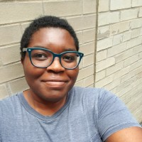
Brief Partnership Updates
We’ve hired a part-time social media specialist!
DiAnre Lazarus – Starts this month, and you’ll meet her in person at the April meeting!
2 More NaloxBoxes coming to Hendricks County

Slide 4
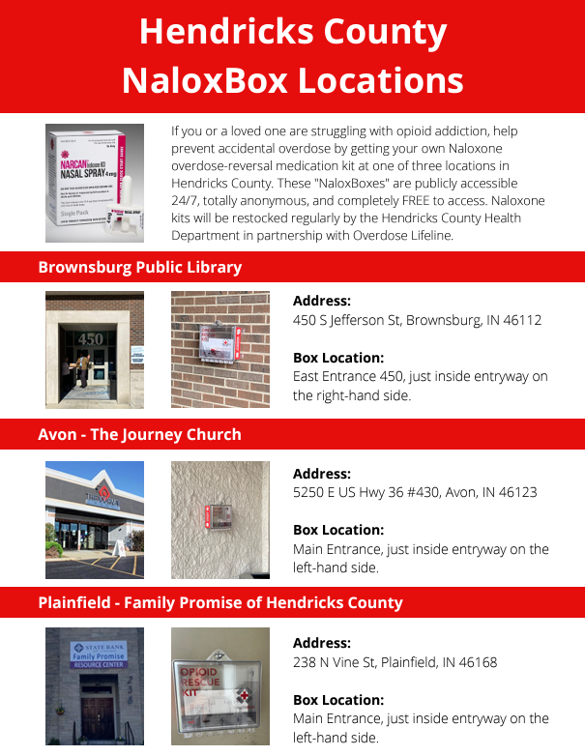
Brief Partnership Updates

Slide 5
Main Presentation
Pam Halliburton
Vice President, Hendricks County Arts Council

Slide 6
+
Hendricks County Health Partnership
Mental Health Awareness Through Art

Slide 7
Who and What is the Hendricks County Arts Council
A local non-profit benefiting all Arts in Hendricks County
Consist of Board of Directors
Advisory Board
The Hendricks County Arts Council believes all people are enriched by an appreciation of and exposure to the arts. We exist to engage the community through awareness of and participation in the arts that are taking place in Hendricks County, Indiana.
Meetings are open to the public and meet the 4th Monday of the Month at the Hendrick's County Fairgrounds

Slide 8
Who Do We Support
Our main organizations are the:
Hendrick’s County Symphony
Hendrick's County theater
Children’s Ballet In Danville
Gallery on the Square (Danville)
Help promote and support 2 annual visual art exhibits Reflected Light and Make an Impression
Now partnering with Hendrick’s Live

Slide 9
What Else Do We Do?
Community Opportunities for other individuals or organizations
Work with Grant Funding and serves as a clearing house for thes projects

Slide 10
Who Am I?
Current Vice President of Arts Council
Visual Artist, Acrylic Painter and Resin Sculptor
Certified Therapeutic Art Coach

Slide 11
2023 Therapeutic Art Workshops
4 Workshops Throughout the Year
Mandala Painting
Vision Boards
Creative Mystery Pouch
Zen Doodling

Slide 12
What’s Next for 2024
Working on a Performance Project
Consisting of metaphorical characters surrounding positive Mental Health Aspects
Props
Audience Interactions
Visual Art

Slide 13
Timing
Tentatively planned for September
Hendrick’s Live Event Space

Slide 14
Open Floor Updates / Needs / Upcoming Events
HCN & Childcare Answers continue to facilitate the 3 Workforce Barriers Taskforces (Housing, Transportation, Childcare) – all are welcome to join and help. Connect with Traci.
April 24th HCN is hosting annual College, Career, Apprenticeship and Trade Fair at the Fairgrounds.
Unlikely Journeys hosting a youth support group on Thursday evenings at Venture Church in Pittsboro, and an adult support group on Sunday evenings at The Willow Center. Flyers available.
Care to Change hosting first ever Faith Leader Summit on May 9th – register online.
PYAP is hosting fundraiser “Performances for a Purpose” at Hendricks Live on June 29th. Info and tickets on website.
Anthem partnering with Indianapolis Colts to facilitate the Classroom Quarterbacks, accepting nominations for scholarship funding and giveaways
Sheriff Shootout on May 10th in Terre Haute hosted by Hamilton Center – still accepting golf teams.
Hamilton Center – WIN Recovery OTP now offering bup. And suboxone in addition to methadone
Susie’s Place offering multiple free trainings throughout the area in April for Child Abuse Awareness Month. Information on their website.
Child Advocates – February – 10 referrals, 4 applications submitted, 5 families on waitlist in Hendricks County. Referrals can be made via 211 or on the CA website, or contact Monay Cavazos directly.

Slide 15
2024 Meeting Calendar:
April 10th – 8:30am at MADE@Plainfield, Community Room – Family Promise Presenting on CAP Goals
May 8th – 8:30am at MADE@Plainfield, Community Room – Professional Development Session: “Minority Mental Health”
May 15th – Quarterly Leaders Meeting / Virtual
July 10th – 8:30am at MADE@Plainfield, Community Room – Care to Change presenting on CAP Goals
August 14th – 8:30am at MADE@Plainfield, Community Room – Professional Development Session: “Suicide Prevention / Q-P-R”
August 21st – Quarterly Leaders Meeting / CCP Virtual
October 2nd (**First Wed. to account for fall breaks) – 8:30am at MADE@Plainfield, Room 233 – HCN Presenting on new Behavioral Health Pipeline Website CAP Goals
November 13th – 8:30am at MADE@Plainfield, Community Room – 2025 Planning Session
December 11th – 8:30am at LOCATION TBD – End of Year Pitch-In Breakfast & Celebration

