Slide 1
Monthly Meeting
March 13th, 2024

Slide 2
Introductions
Any attendees here for the first time are welcome to briefly introduce themselves

Slide 3
Recognition of Service

Slide 4
Brief Partnership Updates
Resource Guide Updates continue. The new beta version will be done soon – hoping to launch it by July, with a full marketing rollout in the fall.

Slide 5
Main Presentation

Slide 6
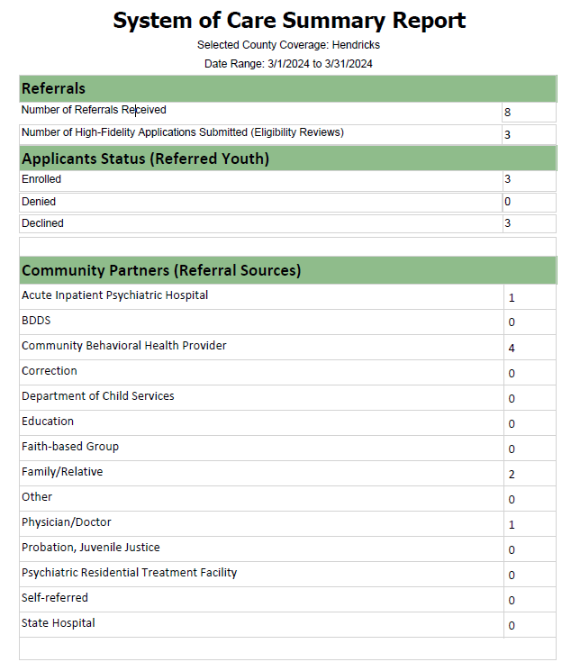
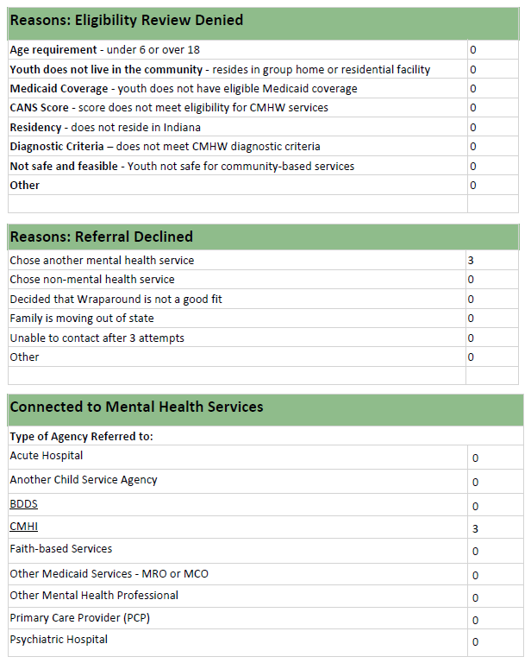
SOC Wraparound Updates
12 families on the Hendricks County waitlist

Slide 7
SOC Wraparound Updates
Children’s Mental Health Program
Statewide Access Site for Wraparound Services: Contact List & Referral Process
Child Advocates is the state-wide access site for all wraparound referrals. To submit a wraparound referral, anyone may:
• Call 2-1-1 and request to submit a referral for wraparound
-or-
• Use the online portal, click “request youth assessment”
https://incmhwportal.fssa.in.gov/

Slide 8
Open Floor Updates / Needs / Upcoming Events
May 9th – Faith Leader Summit: A Christian’s Guide to Mental Health hosted by Care to Change
June 5th – HCCF: next and FINAL round of ARPA grant openings will go live
Narcan box recently installed at IU Health West in Avon
Narcan box coming soon to Cummins BHS Office in Avon
Multiple educators that are part of the Partnership who can train you how to use Narcan
Allendale opening a primary MH inpatient residential program in Ft. Wayne soon – contact Jennifer Ramey for more information.
Used solar eclipse glasses can be donated to AstronomersWithoutBorders, or at local collection boxes throughout the County (including at HCHD inside door 6)
Saturday, May 11th MHAHC Color-Run 5K & Wellness Fair in Avon
MHA national has a toolkit available for social media content during the month of May

Slide 9
2024 Meeting Calendar:
May 8th – 8:30am at MADE@Plainfield, Community Room – Professional Development Session: “Minority Mental Health”
May 15th – Quarterly Leaders Meeting / Virtual
July 10th – 8:30am at MADE@Plainfield, Community Room – Care to Change presenting on CAP Goals
August 14th – 8:30am at MADE@Plainfield, Community Room – Professional Development Session: “Suicide Prevention / Q-P-R”
August 21st – Quarterly Leaders Meeting / CCP Virtual
October 2nd (**First Wed. to account for fall breaks) – 8:30am at MADE@Plainfield, Room 233 – HCN Presenting on new Behavioral Health Pipeline Website CAP Goals
November 13th – 8:30am at MADE@Plainfield, Community Room – 2025 Planning Session
December 11th – 8:30am at LOCATION TBD – End of Year Pitch-In Breakfast & Celebration

Slide 10
LCC Exec. Board – Substance Use Subcommittee “Workshop Briefs”

